Slide 1
Online Sales Dashboard – Business Summary

Slide 2
Objective
To design an interactive dashboard that helps stakeholders analyze and monitor online sales performance using key KPIs and visual insights.

Slide 3
Dataset Overview
Dataset Used : “ Online Sales Dataset – Popular Marketplace Data " (Kaggle)
Key Columns : Transaction ID , Date , Product Name, Product Category , Units Sold, Unit Price ,Total Revenue ,Region,Payment Method

Slide 4
Key Metrics (KPIs)
Total Revenue: ₹78.13K (from your dashboard)
Total Units Sold: 489 units
Sum of Unit Price: ₹55.01K
Number of Transactions: 225

Slide 5
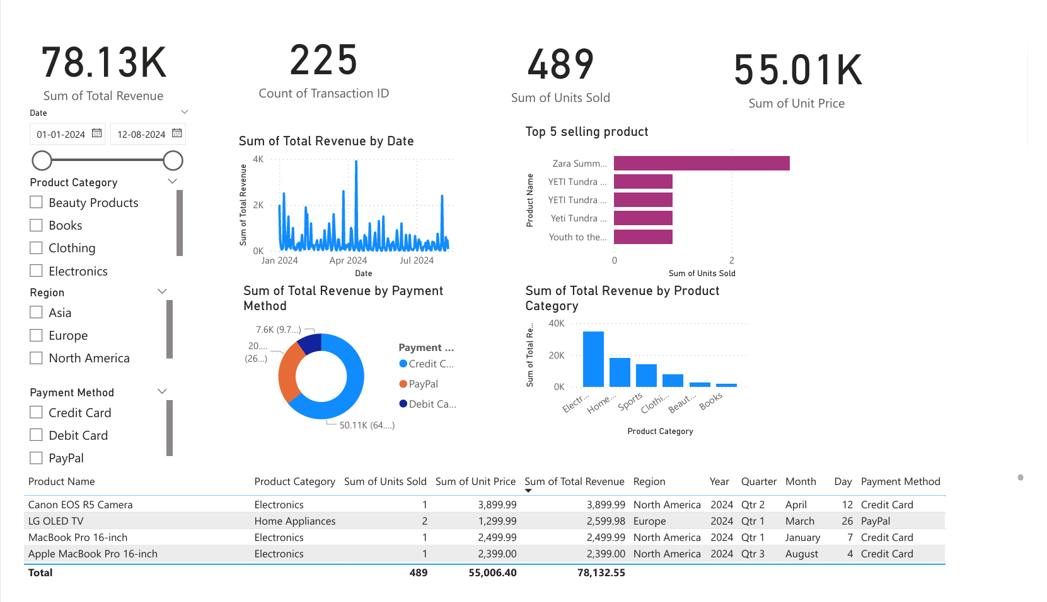
Dashboard Overview
Features : Interactive slicers (Date, Region, Category, Payment)
Line chart for revenue over time
Bar charts for product/category performance
KPI cards for quick summary
Data table for detailed analysis

Slide 6
Insights & Observations
Region North America generated the highest revenue
Product Clothing is the top-selling item
Payment Method Credit Card is most preferred by customers
Category Electronics has low sales, but high unit price

Slide 7
Business Recommendations
Increase stock of top-selling products in high-performing regions
Promote underperforming categories with discounts or bundles
Encourage preferred payment methods to improve user experience
Analyze seasonal trends for better forecasting

Slide 8
Conclusion
The dashboard provides a clear and interactive view of online sales, helping stakeholders:
Track performance over time
Make data-driven decisions
Identify growth opportunities

